Slide 1
Dual Fixed-Point
C. Ewe, P. Cheung, G. Constantinides
Imperial College, London, UK
ACME Seminar
Mark L. Chang
May 4, 2004

Slide 2
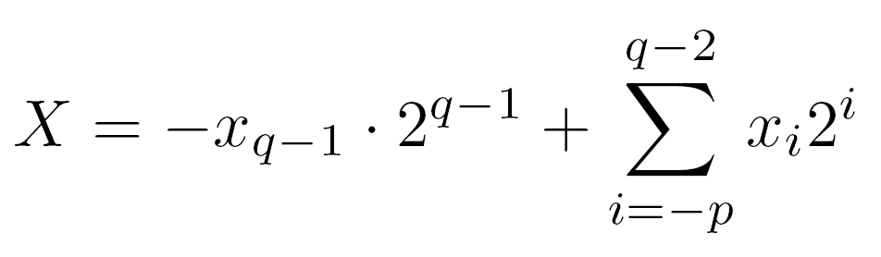
Floating-Point vs. Fixed-Point
Fixed-point
  Partition a binary word into integer and fractional
  Radix point is in a fixed position
  Two’s complement:
  q (integer) + p (fractional) = n

Slide 3
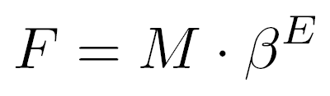
Floating-Point vs. Fixed-Point
Floating-point
  Large dynamic range
  Composed of a mantissa and exponent
Fixed point good for most hardware designs
Floating-point necessary for problems with large dynamic range

Slide 4
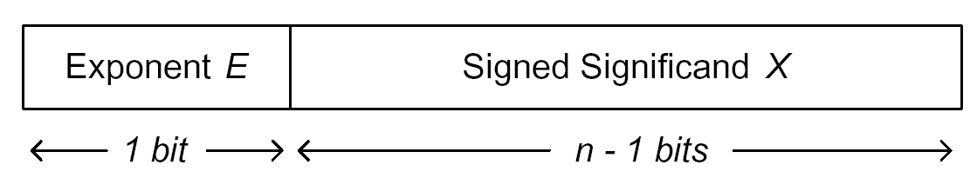
Dual FiXed-point (DFX)
Single Exponent bit (E) selects between two scalings for significand
Two possible ranges for the number
Lower: Num0
Higher: Num1

Slide 5
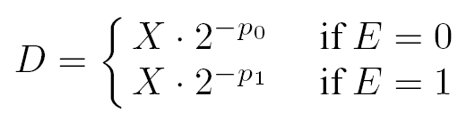
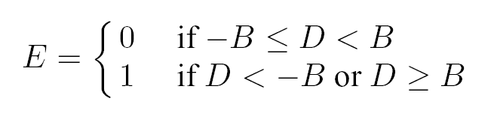
Scaling DFX Numbers
Define two radix points
  p₀ and p₁, p₀ > p₁
  Represent number of bits from the LSB
Boundary value, B used to decide scaling

Slide 6
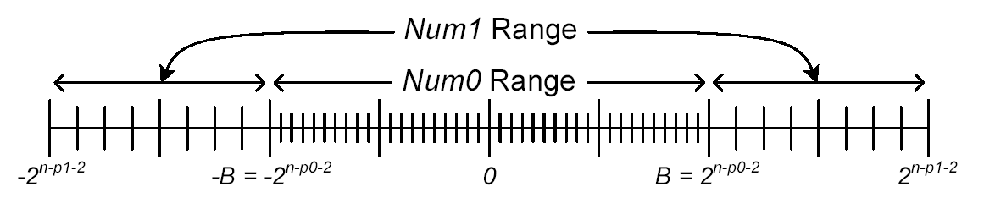
Range of DFX Numbers
DFX Number: n_p₀_p₁
  Number of bits n
  High radix position p₀ yields Num0
  Low radix position p₁ yields Num1

Slide 7

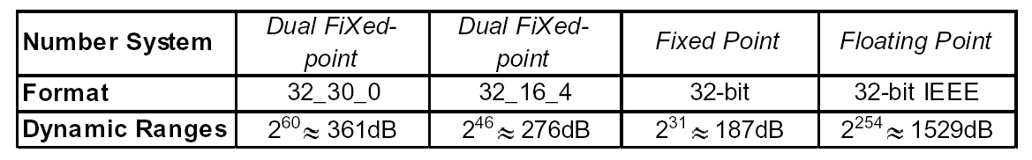
Dynamic Range
Dynamic range = |largest| / |smallest|
Smallest DFX = 2^{-p0}
Largest DFX = 2^{n-p1-2}

Slide 8
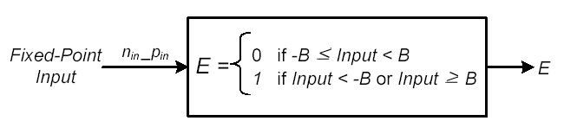
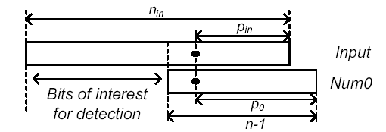
Range Detector
Generates exponent E based on fixed-point input

Slide 9
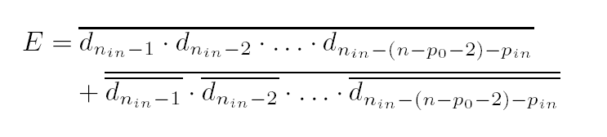
Range Detector Function

Slide 10
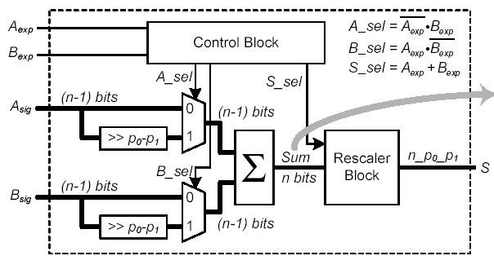
DFX Adder
Fixed-length shift for radix alignment

Slide 11
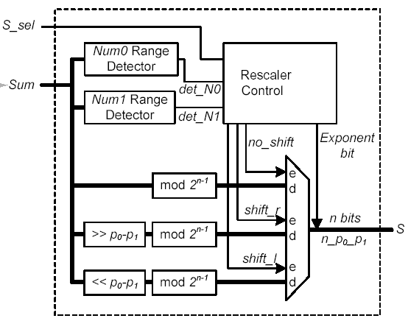
DFX Adder Rescaler

Slide 12
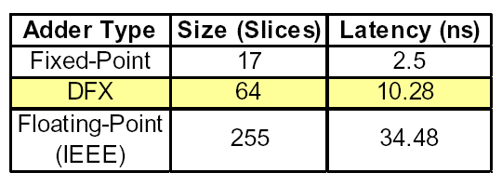
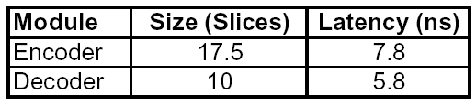
DFX Adder Results
Xilinx Virtex XC2V80
32-bit adders
4x larger and slower than fixed-point
4x smaller and faster than floating-point

Slide 13
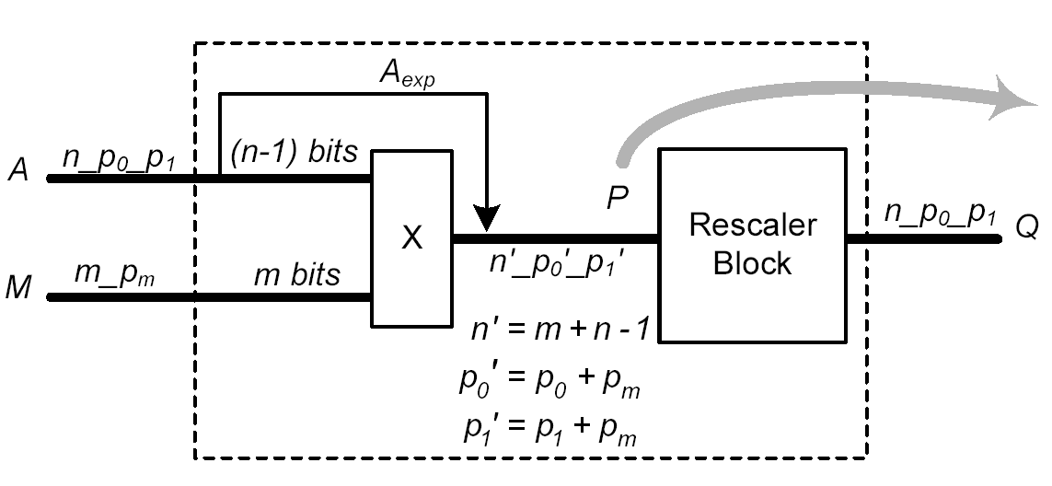
DFX-H Multiplier
DFX-H and DFX-F designed

Slide 14
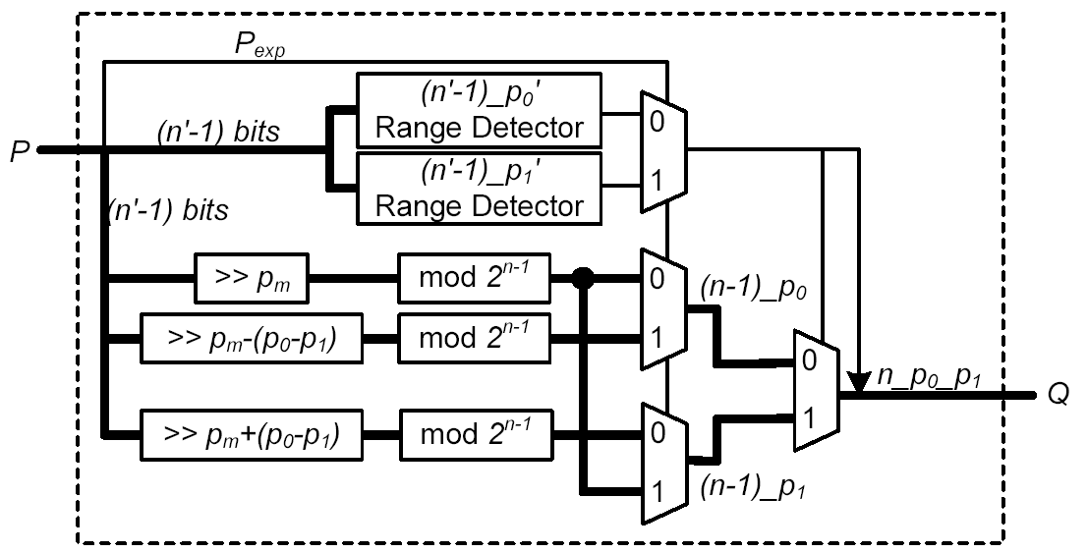
DFX Multiplier Rescaler

Slide 15
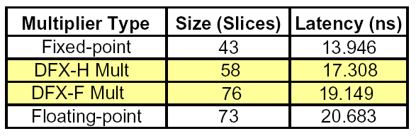
DFX Multiplier Results
DFX-H 1.2x larger and slower than fixed-point
DFX-H 1.2x smaller and faster than FP
DFX-F 1.5 larger and slower than fixed-point
DFX-F comparable to floating-point

Slide 16
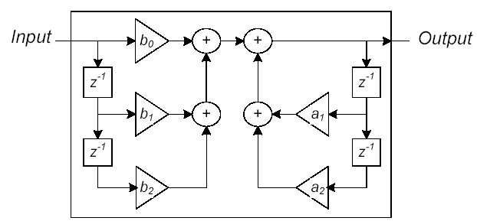
Benchmark: IIR Filter
2nd order notch IIR filter

Slide 17
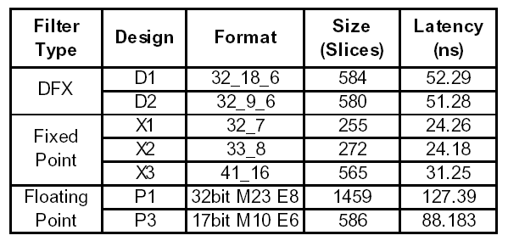
Benchmark Results
Xilinx Virtex II XC2V500

Slide 18
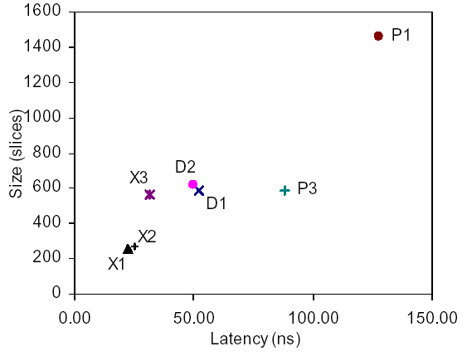
Benchmark Results

Slide 19
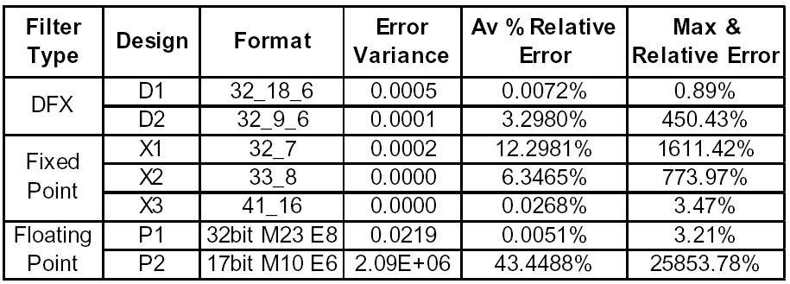
Error Analysis

Slide 20
